Slide 1


10 May 2021
Radford Burger

Slide 2



Slide 3
Inheritance in Java is a mechanism in which one object acquires the properties and behaviors of a parent object.
The idea behind inheritance in Java is that you can create new classes that are built upon existing classes.
When you inherit from an existing class, you can reuse methods and fields of the parent class.

Slide 4
Demonstration using Vehicle class
toString() method
Object class - https://docs.oracle.com/javase/7/docs/api/
Let’s look at another simple application (Rectangle)
Summary

Slide 5
The keyword extends defines a sub-class.
All classes which are not defined with keyword extends, inherit from the class Object.
Only non-private variables and methods are inherited by the sub-class.
Constructors are not inherited.
Keyword super refers to parent-class.
A method defined in the sub-class with the same name as a method in the parent-class, overrides the parent-class method.

Slide 6
public class Rectangle{
private int length;
private int breadth;
public Rectangle(int l, int b){ length = l;
breadth = b;}
public int getLength( ) {
return length( );
public int area( ){
return length * breadth;}
}
public class Box extends Rectangle{
private int height;
public Box(int le, int br, int he){
super( le, br);
height = he; }
public int area( ){
return 2*(height × breadth) + 2*(height × length) + 2*(breadth × length);
}
}
WRONG

Slide 7
The keyword extends defines a sub-class.
All classes which are not defined with keyword extends, inherit from the class Object.
Constructors are not inherited.
Keyword super refers to parent-class.
A method defined in the sub-class with the same name as a method in the parent-class, overrides the parent-class method.
Only non-private variables and methods are inherited by the sub-class.

Slide 8
public class Rectangle{
private int length;
private int breadth;
public Rectangle(int l, int b){ length = l;
breadth = b;}
public int getLength( ) {
return length( );
public int area( ){
return length * breadth;}
}
public class Box extends Rectangle{
private int height;
public Box(int le, int br, int he){
super( le, br);
height = he; }
public int area( ){
return 2*(height × getBreadth( ) ) + 2*(height × getLength( ) ) + 2*(getBreadth( ) × getLength( ) );
}
}

Slide 9
public class Rectangle{
private int length;
private int breadth;
public Rectangle(int l, int b){ length = l;
breadth = b;}
public int getLength( ) {
return length( );
public int area( ){
return length * breadth;}
}
public class Box extends Rectangle{
private int height;
public Box(int le, int br, int he){
super( le, br);
height = he; }
public int area( ){
return 2*(height × getBreadth( ) ) + 2*(height × getLength( ) ) + 2*(super.area( ) );
}
}

Slide 10

public class Rectangle{
protected int length;
protected int breadth;
public Rectangle(int l, int b){ length = l;
breadth = b;}
public int getLength( ) {
return length( );
public int area( ){
return length * breadth;}
}
public class Box extends Rectangle{
private int height;
public Box(int le, int br, int he){
super( le, br);
height = he; }
public int area( ){
return 2*(height × breadth) + 2*(height × length) + 2*(breadth × length);
}
}

Slide 11
public class TestShapes{
public static void main (String[] args){
Rectangle r1 = new Rectangle(5, 4);
System.out.println(“Area of r1: “ + r1.area( ));
Box b1 = new Box(5, 4, 3);
System.out.println(“Area of b1: “ + b1.area( ));
}
}

Slide 12

Demonstration using Vehicle class
toString() method
Object class - https://docs.oracle.com/javase/7/docs/api/
Let’s look at another simple application (Rectangle)
Summary

Slide 13



Summary
Inheritance is a mechanism that allows one class to inherit properties or behaviors from another class.
The parent class is called the superclass, and the derived class is called the subclass.
Subclasses are linked to superclasses using the extends keyword during their definition.

Slide 14



Summary
a child class has IS-A relationship with the parent class.
A superclass can have any number of subclasses. But a subclass can have only one superclass
A subclass does not inherit the private members of its parent class.
Subclasses can define new local methods or fields to use, or can use the super keyword to call inherited methods or the super constructor

Slide 15
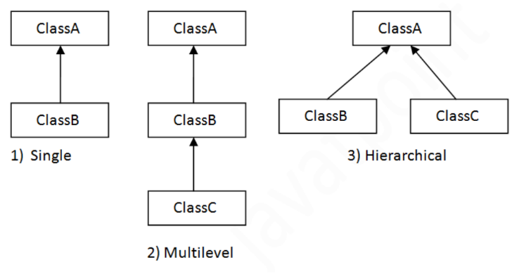

Summary
Multiple classes can inherit from the same parent class, forming a tree-like hierarchy structure

Slide 16
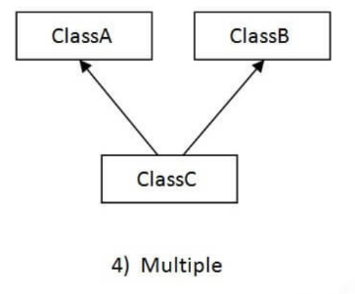

Summary
Java does not support multiple inheritance

Slide 17
Conclusion
Next lesson: continue with inheritance
  Let’s look at our previous Gui application: Lotto project
Revised timetable: ADP2 Mondays @ 9am and Fridays @ 10:30am

